Slide 1
Micro Credit Defaulter Report
By:
Asha Vinod Kumar

Slide 2
Table of contents
1. Introduction
2. Data Visualization
3. Interpretation of Results
4. Conclusion

Slide 3
INTRODUCTION

Slide 4
Business Problem Framing
The main objective of this project is to build a model which can be used to predict in terms of a probability for each loan transaction, whether the customer will be paying back the loaned amount within 5 days of insurance of loan.
Many microfinance institutions (MFI), experts and donors are supporting the idea of using mobile financial services (MFS) which they feel are more convenient and efficient, and cost saving, than the traditional high-touch model used since long for the purpose of delivering microfinance services. Though, the MFI industry is primarily focusing on low income families and are very useful in such areas, the implementation of MFS has been uneven with both significant challenges and successes.

Slide 5
Data Description
Our dataset contains the default status of the users along with the features.
The dataset contains 209593 rows and 36 columns including the target column.
'label' is the target column.
Let’s have a look at the feature columns and its description.

Slide 6
Problem Solving Approaches
We follow the below mentioned approach to get the best predictive model:
Data preparation
Data cleaning
Data analysis
Conclusion

Slide 7
DATA VISUALIZATION

Slide 8
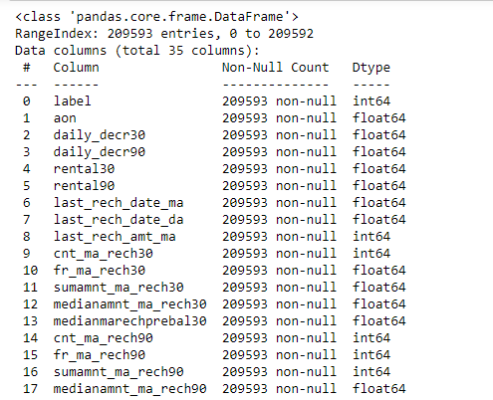
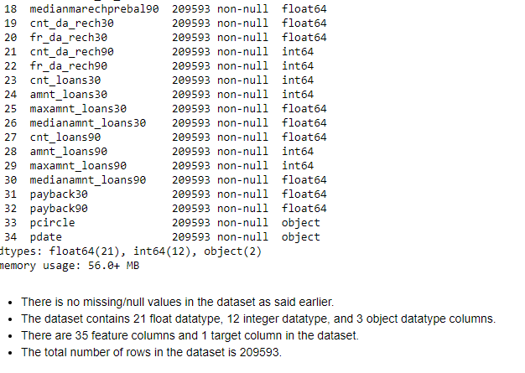
The data types of the dataset are mentioned below:

Slide 9
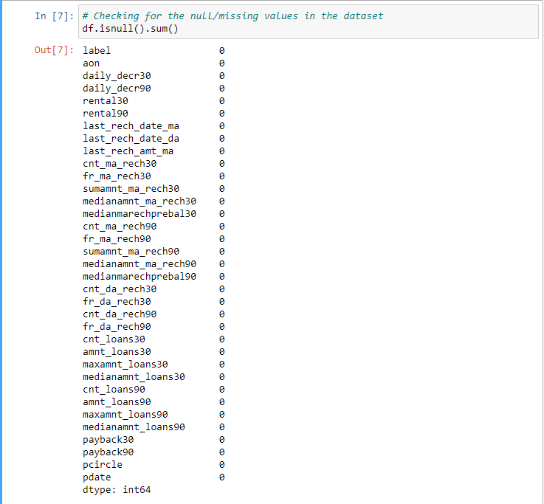
Data Pre-processing checking for the null values in the dataset: after loading the dataset, we checked for the presence of null values or missing values in the dataset. we found that there were no null values in the dataset.
[{"metadata":{"trusted":true},"id":"d2b995ed","cell_type":"code","source":"# Checking for the null/missing values in the dataset\ndf.isnull().sum()","execution_count":7,"outputs":[{"data":{"text/plain":"label 0\naon 0\ndaily_decr30 0\ndaily_decr90 0\nrental30 0\nrental90 0\nlast_rech_date_ma 0\nlast_rech_date_da 0\nlast_rech_amt_ma 0\ncnt_ma_rech30 0\nfr_ma_rech30 0\nsumamnt_ma_rech30 0\nmedianamnt_ma_rech30 0\nmedianmarechprebal30 0\ncnt_ma_rech90 0\nfr_ma_rech90 0\nsumamnt_ma_rech90 0\nmedianamnt_ma_rech90 0\nmedianmarechprebal90 0\ncnt_da_rech30 0\nfr_da_rech30 0\ncnt_da_rech90 0\nfr_da_rech90 0\ncnt_loans30 0\namnt_loans30 0\nmaxamnt_loans30 0\nmedianamnt_loans30 0\ncnt_loans90 0\namnt_loans90 0\nmaxamnt_loans90 0\nmedianamnt_loans90 0\npayback30 0\npayback90 0\npcircle 0\npdate 0\ndtype: int64"},"execution_count":7,"metadata":{},"output_type":"execute_result"}]}]

Slide 10
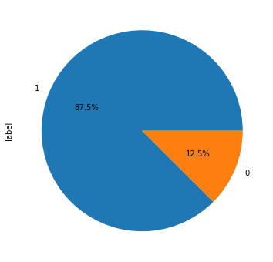
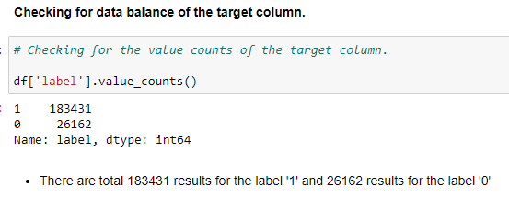
checking target column is balanced or not.
As per the observation, approx. 87.5% users paid back the credit amount and 1.5% users failed to pay the credit.
This shows that the target column is imbalanced.

Slide 11
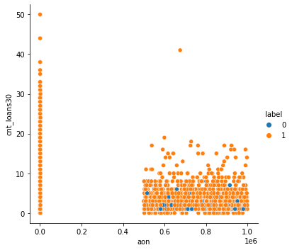
relationship of age on cellular network with target column.
we can say that as the number of days of users increases the chances of defaulters also increases. This is for the users who have taken the loan in last 30 days.

Slide 12
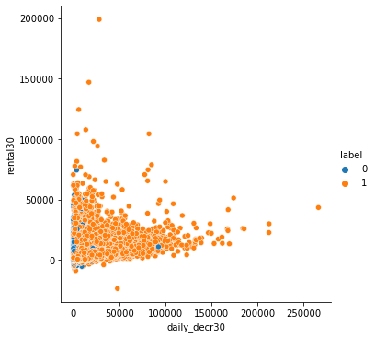
relation between average main account balance of users in last 30 days and daily amount spend in last 30 days.
The graph shows that as the average main account balance of the users are increasing their spending are also increasing.
If we talk about the credit defaulters, it is more for the users who is spending less and the average main balance in the last 30 days is below 50,000.

Slide 13
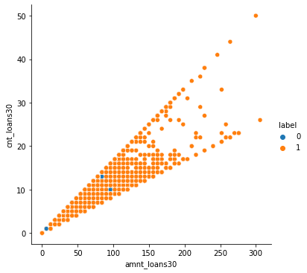
total amount of loan taken and the number of loan taken by the users in last 30 days.
We can see that as the amount is increasing the number of loan is also increasing.
Users who have taken less number of loans (below 20) and for less amount (below or equal to 100) some of them have failed to pay back the amount.

Slide 14
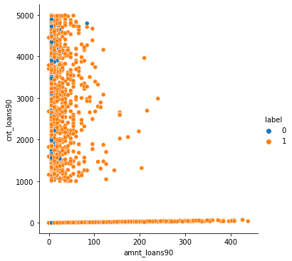
relation between total amount of loan taken by the users in 90 days and number of loan taken.
We found that the number of defaulters are more for 90 days but the loan amount is below 100.

Slide 15
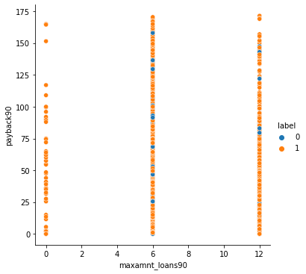
the number of defaulters are more for 90 days but the loan amount is below 100.
From the graph we can say that as the number of days of pay back is increasing the number of defaulters are also increasing.

Slide 16
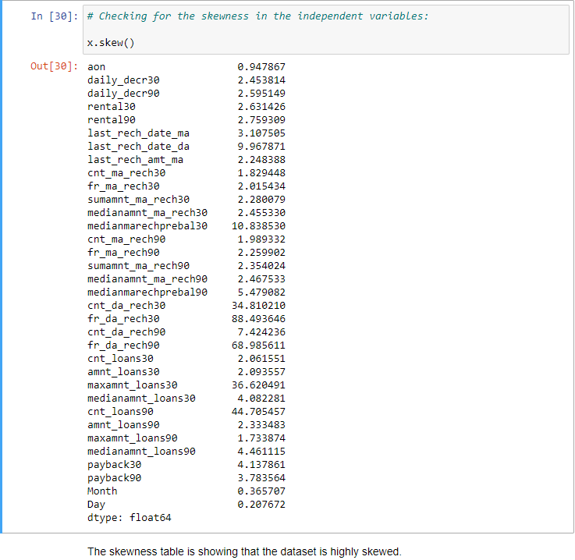
Checking for skewness
Skewness in the dataset:

Slide 17
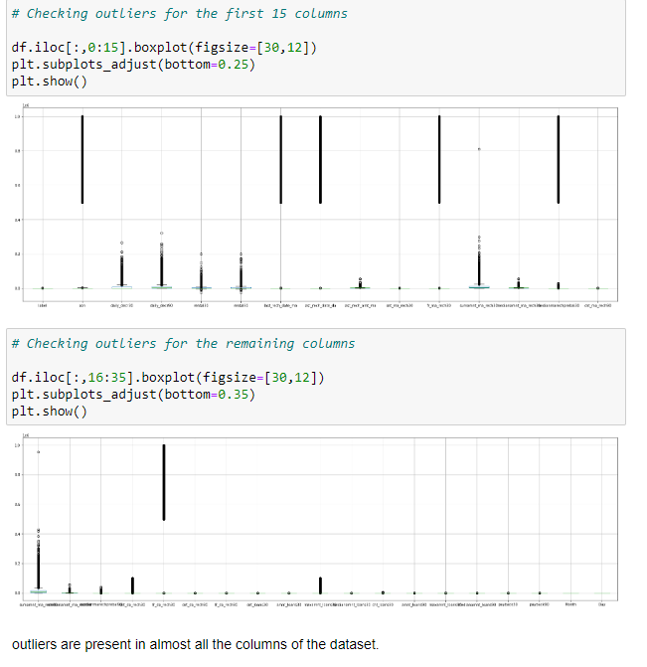
Checking for outliers

Slide 18
Hardware and Software Requirements and Tools Used:

Slide 19
Statistical Summary & Correlation Table

Slide 20
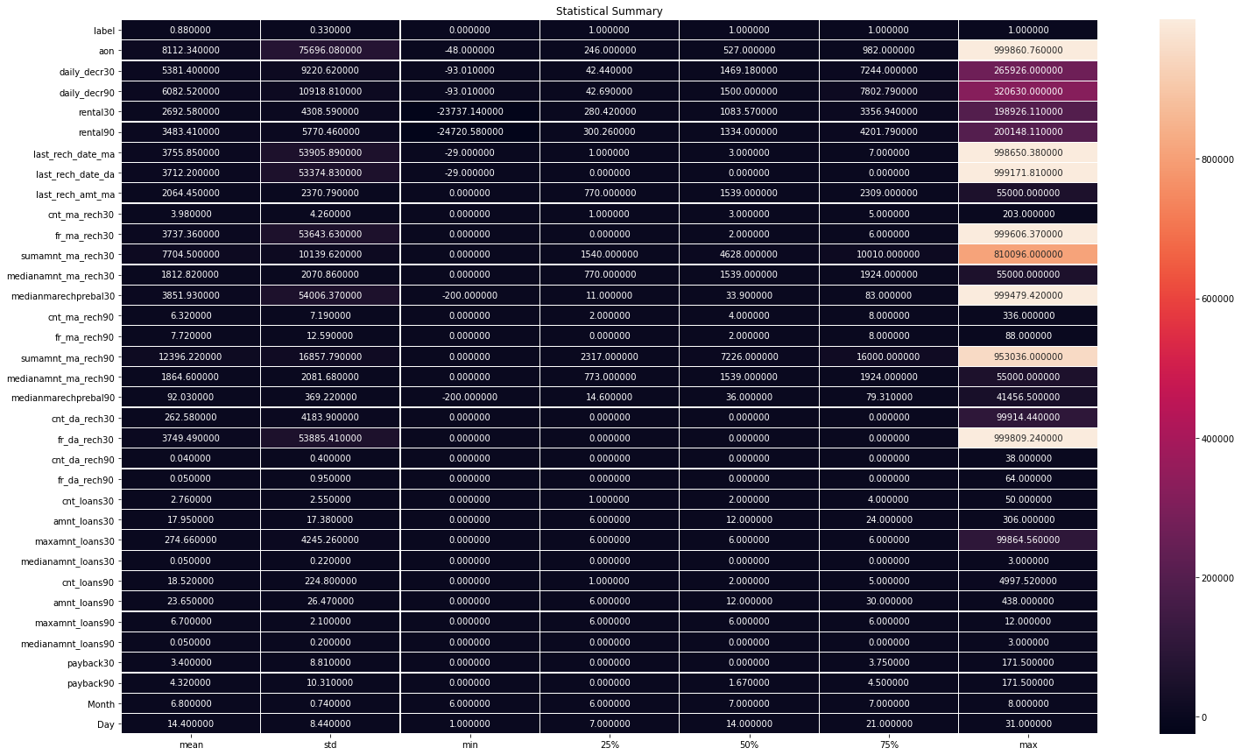

Slide 21
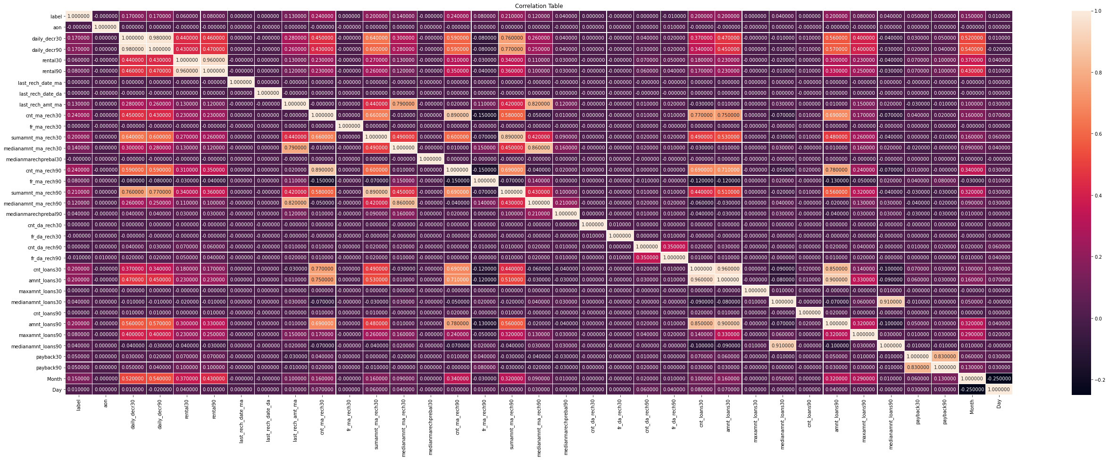
Correlation Table:

Slide 22
Outcomes of Correlation Table:
Number of times account got recharged in 30 days & 90 days have the maximum correlation with the target column. It have 24% correlation which can be considered as strong bond.
Total amount of recharge in main account over last 90 days have 21% correlation with the target column which can be considered as strong bond.
Total amount of recharge in main account over last 30 days, Number of loans taken by user in last 30 days, total amount of loans taken in 30 days, and 90 days columns are showing 20% correlation with the target column which can be considered as good bond.

Slide 23
Model/s Development and Evaluation:
Below are the algorithms which we used for the training and testing:
Logistic Regression.
Ridge Classifier.
Random Forest Classifier.
Decision Tree Classifier.
Gaussian NB.

Slide 24
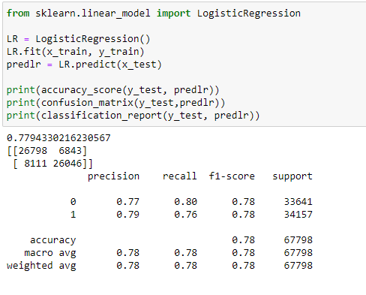
1. Logistic Regression:

Slide 25
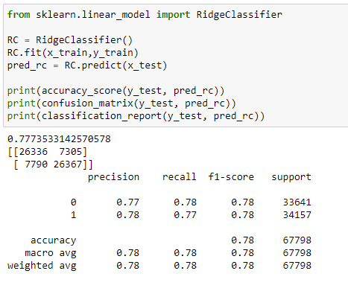
2. Ridge Classifier:

Slide 26
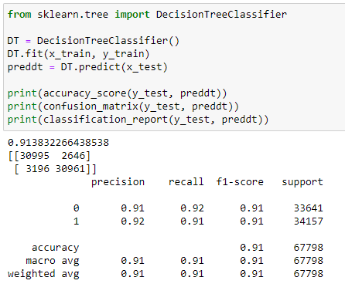
3. Decision tree Classifier:

Slide 27
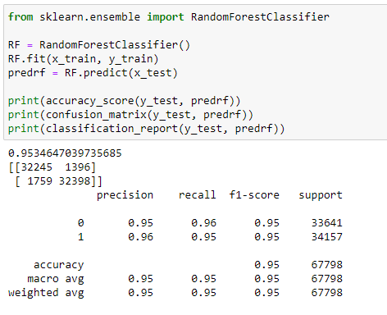
4. Random forest Classifier:

Slide 28
Conclusion:
Key Findings:
If the number of days of payback is increasing the chance of defaulters is also increasing. So, we should look for the payback duration.
If the loan amount is below 100 and the number of loans taken by users is 90 days, the number of defaulters is increasing.

Slide 29
Conclusions of the Study:
Users who uses the services for short time.
Users whose average daily spend amount is less.
Users whose main account balance is low.
Users who do not recharge frequently or they recharge for very few times in the last 30 or 90 days.
Users whose recharge amount is less.
Users who opt for less amount of loan are more defaulter as compared to the users who opt for loan more amount.

Slide 30
Thank you!

